Slide 1
Building Resilient Supply Chains for Natural Disasters
By: Arushi Arora, Chenxuan Fu, Mason Lo, Ruozhu Shen, and Srihan Yerubandi
Group 11: Introduction to SCM: 33:799:301:08
March 24, 2026

Slide 2
Agenda
Natural Disaster Risks and Their Effects on the Supply Chain
Examples of Major Disruptions Caused by Natural Disasters
Resilience Strategies
Examples of Companies Effectively Managing Disaster Risks
Framework for Disaster-Resilient Supply Chains
Arushi Arora

Slide 3
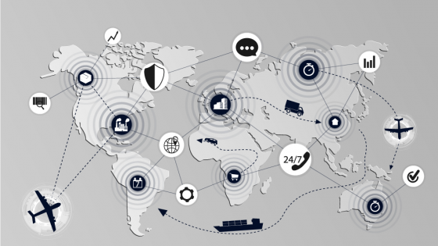
Natural Disaster Risks and Their Effects on the Supply Chain
Natural Disaster Risks:
Natural disasters are composed of geophysical, meteorological, and hydrological events. These include earthquakes, volcanic eruptions, hurricanes, floods, etc.
Natural disasters pose severe threats to supply chains. As supply networks have grown more complex, the blast radius of localized disasters have expanded globally.
Effects on Supply Chains:
First order effects: The immediate damage from the epicenter of the event. These include loss of inventory, equipment damage, and facility condemnation.
Second order effects: The disruption spreads beyond the impact zone. These include transportation bottlenecks, utility blackouts, and telecommunications failures.
Third order effects: The delayed reactions to the event, driven by the bullwhip effect. These include demand surges, panic buying, and cost inflation.
Mason Lo

Slide 4
Examples of Major Disruptions Caused by Natural Disasters
Chenxuan Fu

Slide 5
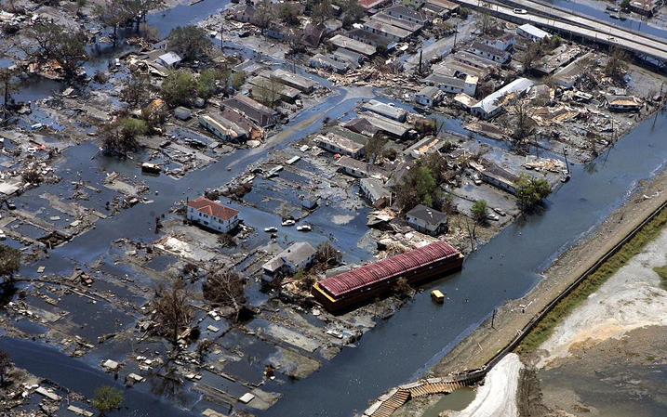
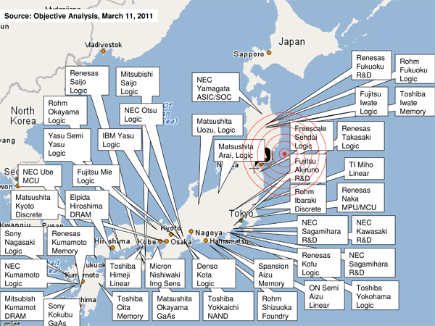
Major Natural Disaster Disruptions
Hurricane Katrina (2005, USA)
  Hurricane Katrina shut down the Port of New Orleans, disrupting a major trade route
  It reduced U.S. oil supply and caused fuel shortages
  Transportation damage led to nationwide logistics delays
Japan Earthquake & Tsunami (2011)
  The disaster shut down key automotive and semiconductor factories.
  It caused shortages of critical components like chips
  Companies such as Toyota and Sony faced production delays
  The just-in-time system failed due to lack of inventory
Chenxuan Fu

Slide 6
Common Impacts:
  Natural disasters damage infrastructure such as ports, roads, and warehouses
  They disrupt suppliers and delay transportation flows
Business Consequences:
Supply Chain Impact Analysis
  These disruptions lead to inventory shortages and production stoppages
  They also increase operational costs for companies
Key Insight:
  Local disasters can quickly spread through global supply chains
  Overdependence on a single supplier increases vulnerability
Chenxuan Fu

Slide 7
Resilience Strategies
Srihan Yerubandi

Slide 8
Geographic Risk Mapping
Multi-Sourcing
Buffer Inventory
Using historical disaster patterns and data to identify which suppliers, facilities, and transportation routes sit in high-risk geographic zones
Assessing how parts of the supply chain are exposed to natural hazards in order to pinpoint the most vulnerable locations
Redesigning the supply chain in order to shift critical operations from disaster-prone regions to lower-risk areas
Positioning your inventory, capacity, and key logistics in safer locations ahead of seasonal disaster risks to maintain continuity
Maintaining additional safety stock of critical materials in advance for short-term disruptions
Distributing your inventory across multiple warehouses so a single facility outage doesn’t halt company operations
Providing enough extra inventory to keep operations running while backup suppliers or logistics changes take effect
Reducing reliance on emergency sourcing by ensuring essential inputs are available during shutdowns
Having multiple qualified suppliers for key materials in order to avoid dependence on a single supplier
Spreading your suppliers across different regions in order to reduce your exposure to localized natural disasters
Rapidly shifting your orders when one supplier is disrupted
Ensuring that your suppliers use different production techniques so a disruption affecting one technique doesn’t affect all of them
Srihan Yerubandi

Slide 9
Examples of Companies Effectively Managing
Disaster Risks
Arushi Arora

Slide 10
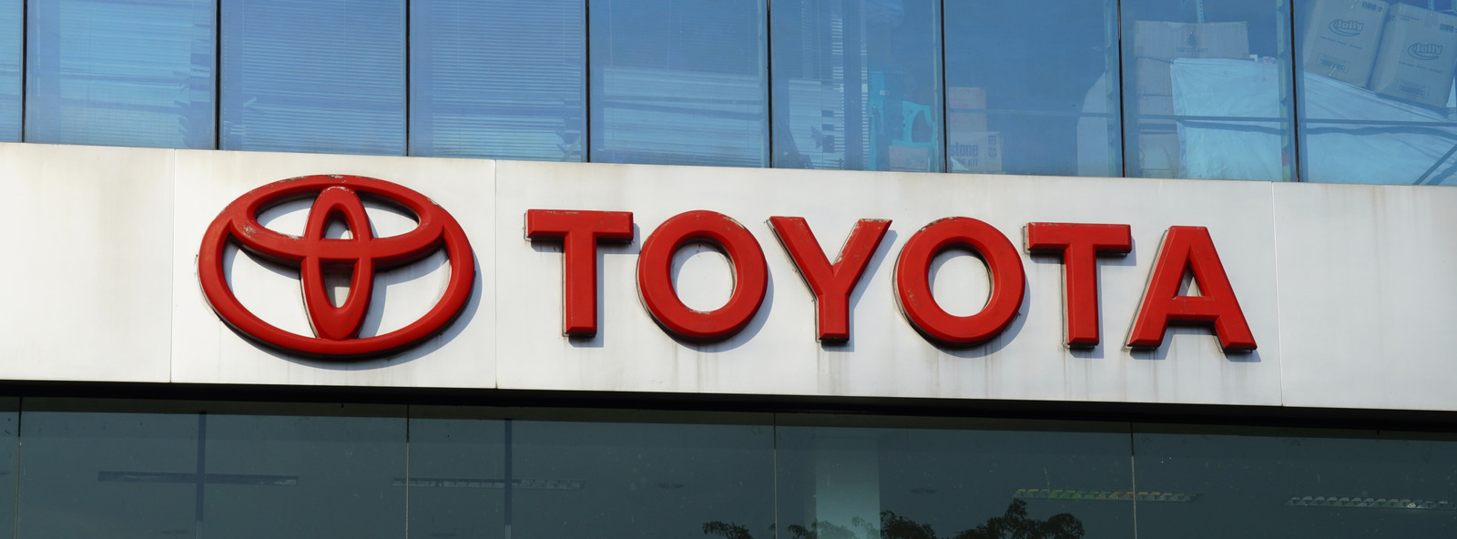

Toyota
Apple
2011 Earthquake and tsunami
  77% (~$1.4B) fall in profits
  Shortage of Japanese manufactured parts → 30% production drop in North America
Revised Toyota Production Plan
  Standardized parts
  Multi-sourcing
  Required suppliers to hold inventory
2016 Earthquakes
  Resumed production in 2-4 weeks
  Lost limited to ~$277 M
Thai floods in 2011
  Global hard-drive shortage → Risk to PC manufacturers, including Apple
Apple Response
  Just-In-Time model → supply chain visibility
  Identified shortages & shifted production
As a result
  Minimal disruption/delays to Macbooks
  Stable share price + Mac sale growth
Arushi Arora

Slide 11
Framework for Disaster-Resilient
Supply Chains
Ruozhu Shen

Slide 12
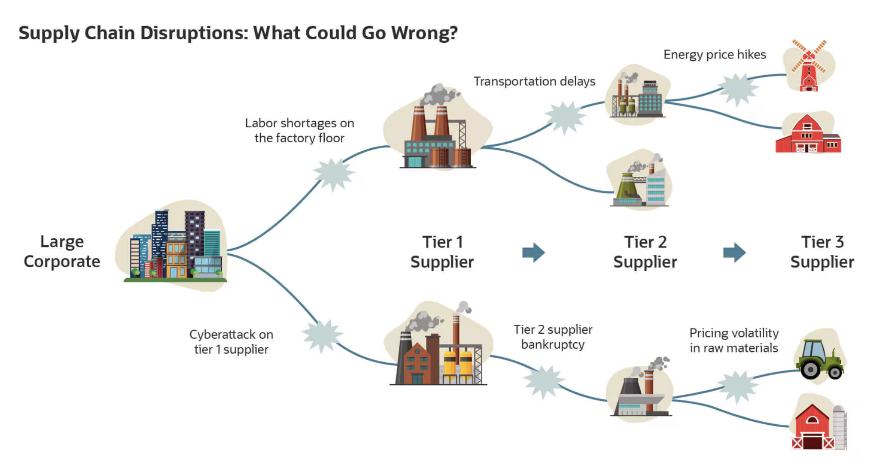
Five Key Elements
1. Risk Identification
Companies must identify potential risks in their supply chains. This includes understanding which suppliers, factories, or transportation routes are vulnerable to natural disasters.
2. Supplier Diversification
Companies should diversify their suppliers. Relying on only one supplier in a single region can be very risky. By working with multiple suppliers in different locations, businesses can continue production even if one supplier is affected by a disaster.
Ruozhu Shen

Slide 13
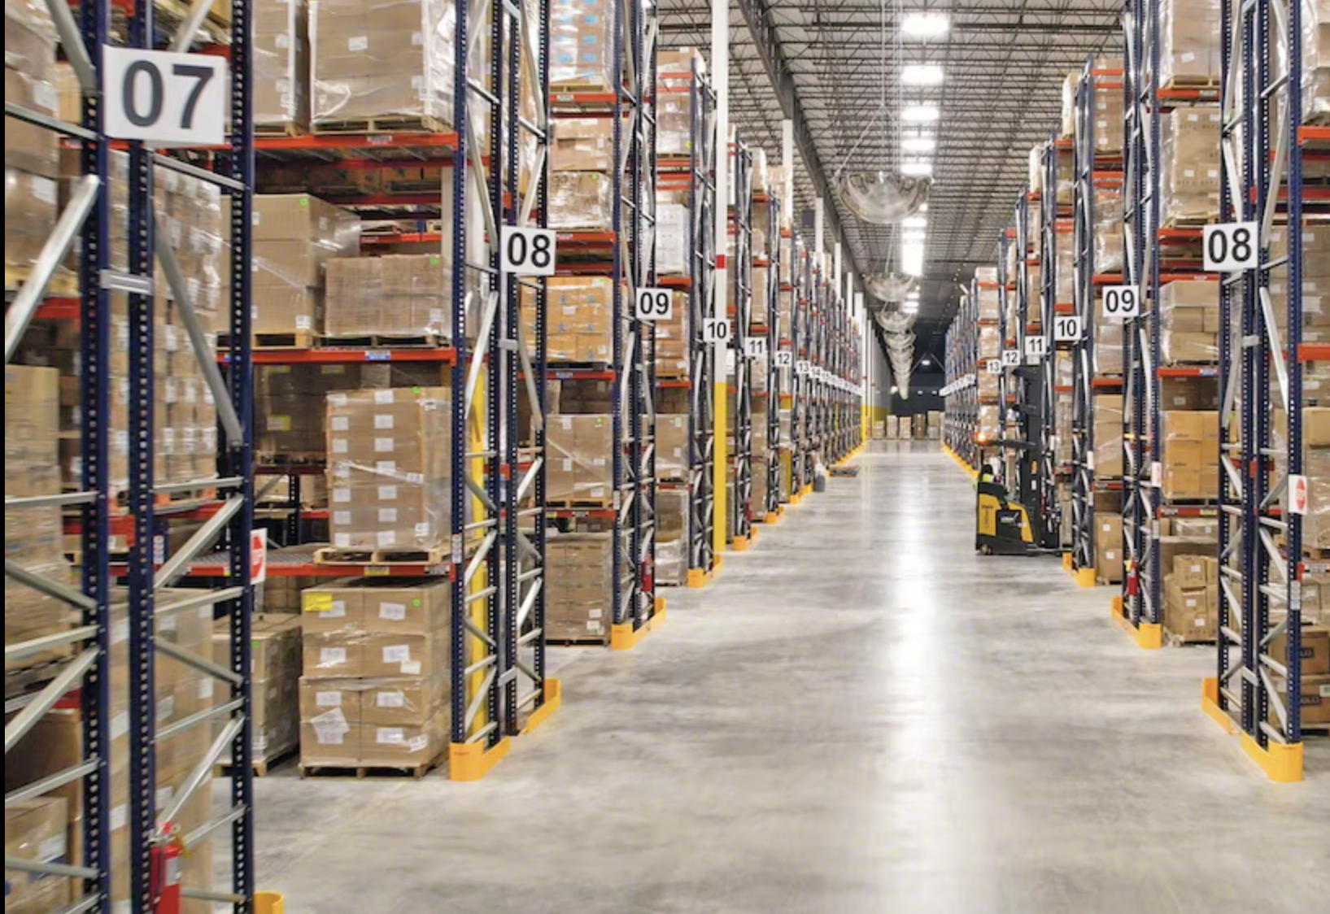
Five Key Elements Cont.
3. Inventory and Capacity Buffers
Companies should maintain safety stock and backup production capacity. Extra inventory and alternative production facilities can help companies continue operations when disruptions occur.
4. Digital Visibility
Technology plays an important role. Digital tools and real-time data systems allow companies to monitor their supply chains and respond quickly when problems arise.
5. Recovery and Communication plans
Companies need clear recovery plans and strong communication with suppliers and partners. A well-prepared recovery strategy helps businesses restore operations faster after a disaster.
Ruozhu Shen

Slide 14
References
Straight, Brian. “Disaster Supply Chains Depend on ALAN to Get the Logistics Right.” Supply Chain Management Review, 5 Sept. 2024. Web. 24 Mar. 2026, https://www.scmr.com/article/disaster-supply-chains-depend-on-alan-to-get-the-logistics-right
Park, YoungWon, Paul Hong, and James Jungbae Roh.“Supply Chain Lessons from the Catastrophic Natural Disaster in Japan.” Business Horizons, vol. 56, no. 1, 2013, pp. 75–85. Web. 24 Mar. 2026. https://www.sciencedirect.com/science/article/abs/pii/S0007681312001279
Development, UNC Executive. “Building Resilient Supply Chains in a Changing World.” UNC Executive Development, 20 Nov. 2025, execdev.unc.edu/resilient-supply-chains/?utm_source=copilot.com
Shekarabi, Seyed Ashkan Hosseini, et al. “Supply Chain Resilience: A Critical Review of Risk Mitigation, Robust Optimisation, and Technological Solutions and Future Research Directions.” Global Journal of Flexible Systems Management, vol. 26, no. 3, July 2025, pp. 681–735. https://doi.org/10.1007/s40171-025-00458-8. Accessed 22 Mar. 2026.
WMG, University of Warwick, et al. “Supply Chain Resilience Framework and a Methodology for Creating Supply Chain Resilience Index.” Supply Chain Resilience for Manufacturing Supply Chains, Digital Catapult and Made Smarter Innovation, 2023, warwick.ac.uk/WMG. Accessed 22 Mar. 2026.
“Natural Disasters.” Fed Small Business, www.fedsmallbusiness.org/topics/natural-disasters. Accessed 22 Mar. 2026.

Slide 15
References
Leonard, Matt. “Toyota, Citing Lessons Learned from 2011 Earthquake, Expects No Major Semiconductor Impact.” Supply Chain Dive, TechTarget, 14 May 2021, www.supplychaindive.com/news/toyota-semiconductor-shortage-earthquake-inventory-ihs-gartner-forecast-2022/600193/. Accessed 22 Mar. 2026.
Trudell, Craig. “Toyota Seen Losing $277 Million as Quakes Halt Japan Output.” Bloomberg, Bloomberg, 17 Apr. 2016, www.bloomberg.com/news/articles/2016-04-18/toyota-seen-losing-277-million-from-japan-earthquake-stoppages. Accessed 22 Mar. 2026.
Giovanni. “The Last Dance of Just-In-Time?” Digital Initiative, 15 Nov. 2017, d3.harvard.edu/platform-rctom/submission/the-last-dance-of-just-in-time/. Accessed 22 Mar. 2026.
Yang, Jun. “Worst Thai Floods in 50 Years Hit Apple, Toyota Supply Chain.” Bloomberg, Bloomberg, 21 Oct. 2011, www.bloomberg.com/news/articles/2011-10-20/worst-thai-floods-in-50-years-hit-apple-toyota-supply-chains. Accessed 22 Mar. 2026.
Trefis Team. “Apple Still On Track For $502 Share Price Despite Thai Floods.” Forbes, 15 Nov. 2011, www.forbes.com/sites/greatspeculations/2011/11/15/apple-still-on-track-for-502-share-price-despite-thai-floods/. Accessed 22 Mar. 2026.
Chris Foresman, Chris. “Thai Flooding Leaves Apple with 2TB Drive Shortage.” Ars Technica, 2 Dec. 2011, arstechnica.com/gadgets/2011/12/thai-flooding-finally-hits-apple-with-2tb-drive-shortage/. Accessed 22 Mar. 2026.

